Slide 1


Linear Algebra Week 8: Singular Value Decomposition and Image Compression Project
Time：2025.1006
Li Zhenping

Slide 2
Session 1: SVD Introduction Singular Value Decomposition Overview Geometric Interpretation

Slide 3
Session 1: SVD Introduction Singular Value Decomposition Overview

Slide 4

Review: $Av=λv (A is matrix, v is eigenvector,λ is eigenvalue)$
An eigenvector of a matrix A is a nonzero vector v such that:
$$Av=λv$$
Where:
A is an n x n square matrix (the linear transformation)
v is a nonzero vector (the eigenvector)
$λ$ is a scalar (the eigenvalue)
Meaning of each part:
A: represents the linear transformation (rotation, scaling, reflection, etc.)
V: the special vector whose direction is preserved under A
$λ$: the scale factor

Slide 5
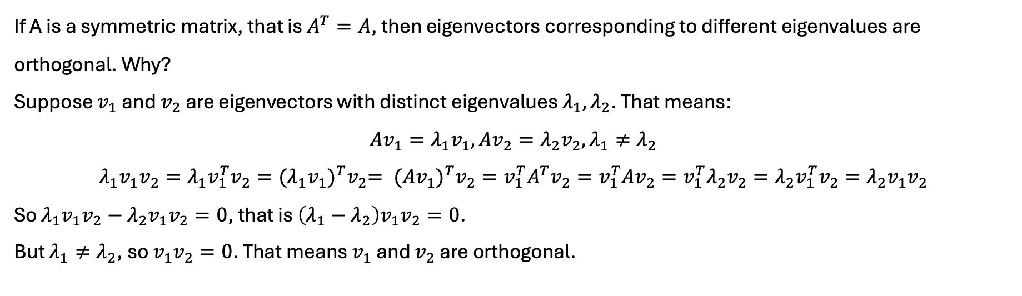
Properties: Symmetric matrices have orthogonal eigenvectors
If A is a symmetric matrix, that is $A^{T}=A$, then eigenvectors corresponding to different eigenvalues are orthogonal. Why?
Suppose $v_{1}$ and $v_{2}$ are eigenvectors with distinct eigenvalues $λ_{1},λ_{2}$. That means:
$$Av_{1}=λ_{1}v_{1},Av_{2}=λ_{2}v_{2},λ_{1}≠λ_{2}$$
$$λ_{1}v_{1}v_{2}=λ_{1}v_{1}^{T}v_{2}{={(λ_{1}v_{1})}^{T}v}_{2}= {(Av_{1})}^{T}v_{2}=v_{1}^{T}A^{T}v_{2}=v_{1}^{T}Av_{2}=v_{1}^{T}λ_{2}v_{2}=λ_{2}v_{1}^{T}v_{2}=λ_{2}v_{1}v_{2}$$
So $λ_{1}v_{1}v_{2}−λ_{2}v_{1}v_{2}=0$, that is $\left(λ_{1}−λ_{2}\right)v_{1}v_{2}=0$.
But $λ_{1}≠λ_{2}$, so $v_{1}v_{2}=0$. That means $v_{1}$ and $v_{2}$ are orthogonal.

Slide 6
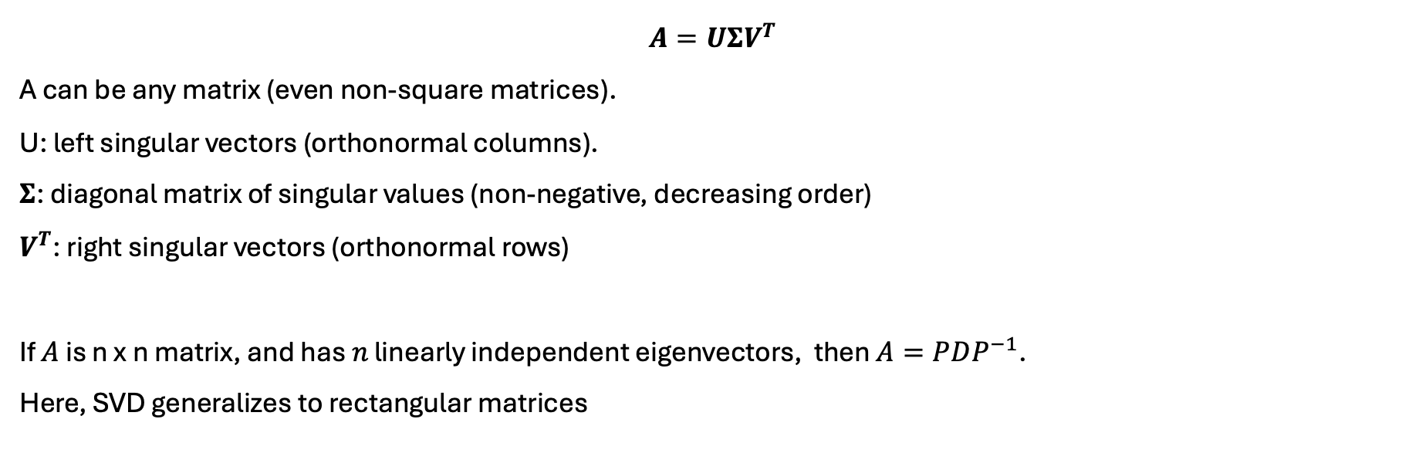
Definition: The Singular Value Decomposition: $A=UΣV^{T}$
$$A=UΣV^{T}$$
A can be any matrix (even non-square matrices).
U: left singular vectors (orthonormal columns).
$Σ$: diagonal matrix of singular values (non-negative, decreasing order)
$V^{T}$: right singular vectors (orthonormal rows)
If 𝐴 is n x n matrix, and has 𝑛 linearly independent eigenvectors, then $A=PDP^{−1}$.
Here, SVD generalizes to rectangular matrices

Slide 7
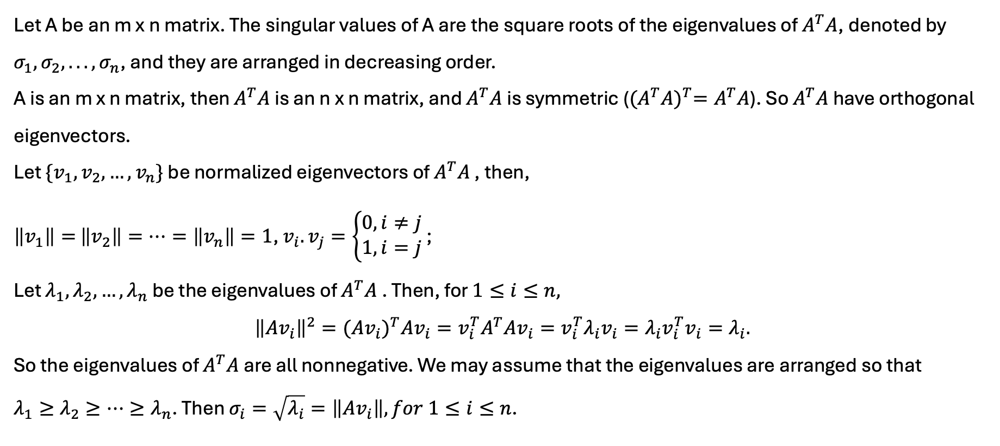
Definition : the singular values of an m x n matrix
Let A be an m x n matrix. The singular values of A are the square roots of the eigenvalues of $A^{T}A$, denoted by $σ_{1}, σ_{2}, . . . , σ_{n}$, and they are arranged in decreasing order.
A is an m x n matrix, then $A^{T}A$ is an n x n matrix, and $A^{T}A$ is symmetric (${(A^{T}A)}^{T}=A^{T}A$). So $A^{T}A$ have orthogonal eigenvectors.
Let $\{v_{1},v_{2},…,v_{n}\}$ be normalized eigenvectors of $A^{T}A$ , then,
$\left\|v_{1}\right\|=$ $\left\|v_{2}\right\|=…=\left\|v_{n}\right\|=1$, $v_{i}.v_{j}=\left\{\begin{aligned}0, i≠j \\ 1, i=j\end{aligned}\right.$ ;
Let $λ_{1},λ_{2},…,λ_{n}$ be the eigenvalues of $A^{T}A$ . Then, for $1≤i≤n,$
$${\left\|Av_{i}\right\|}^{2}={(Av_{i})}^{T}Av_{i}=v_{i}^{T}A^{T}Av_{i}=v_{i}^{T}λ_{i}v_{i}=λ_{i}v_{i}^{T}v_{i}=λ_{i}.$$
So the eigenvalues of $A^{T}A$ are all nonnegative. We may assume that the eigenvalues are arranged so that
$λ_{1}≥λ_{2}≥…≥λ_{n}$. Then $σ_{i}=\sqrt{λ_{i}}=\left\|Av_{i}\right\|, for 1≤i≤n$.

Slide 8
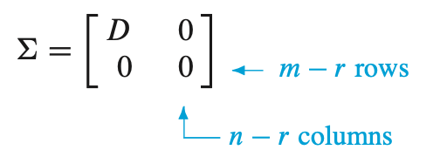

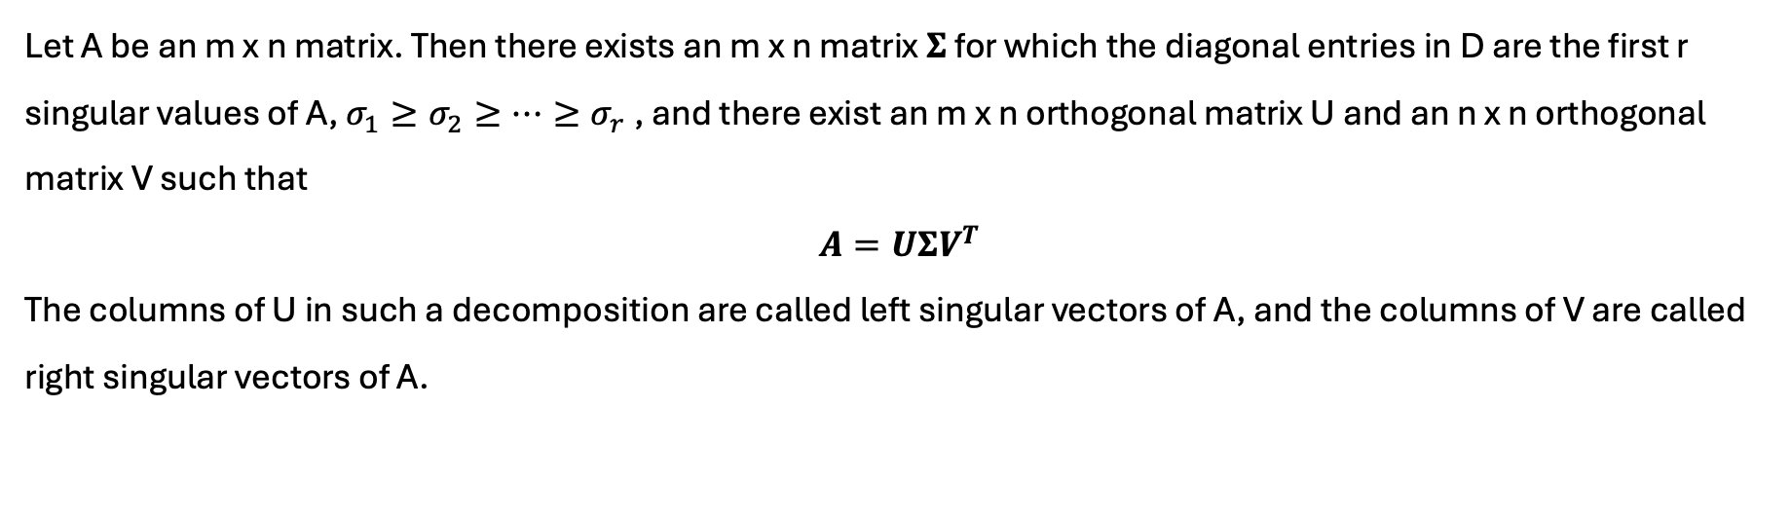
The Singular Value Decomposition: $A=UΣV^{T}$
Let A be an m x n matrix. Then there exists an m x n matrix $Σ$ for which the diagonal entries in D are the first r singular values of A, $σ_{1}≥σ_{2}≥…≥σ_{r}$, and there exist an m x n orthogonal matrix U and an n x n orthogonal matrix V such that
$$A=UΣV^{T}$$
The columns of U in such a decomposition are called left singular vectors of A, and the columns of V are called right singular vectors of A.
$$D=\left[\begin{matrix}σ_{1} & 0 & 0 & 0 & 0 \\ 0 & σ_{2} & 0 & 0 & 0 \\ 0 & 0 & . & 0 & 0 \\ 0 & 0 & 0 & . & 0 \\ 0 & 0 & 0 & 0 & σ_{r}\end{matrix}\right]$$

Slide 9
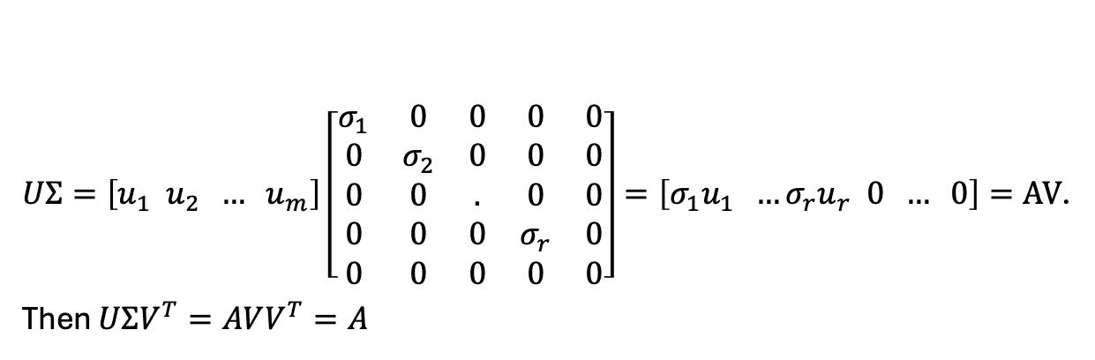
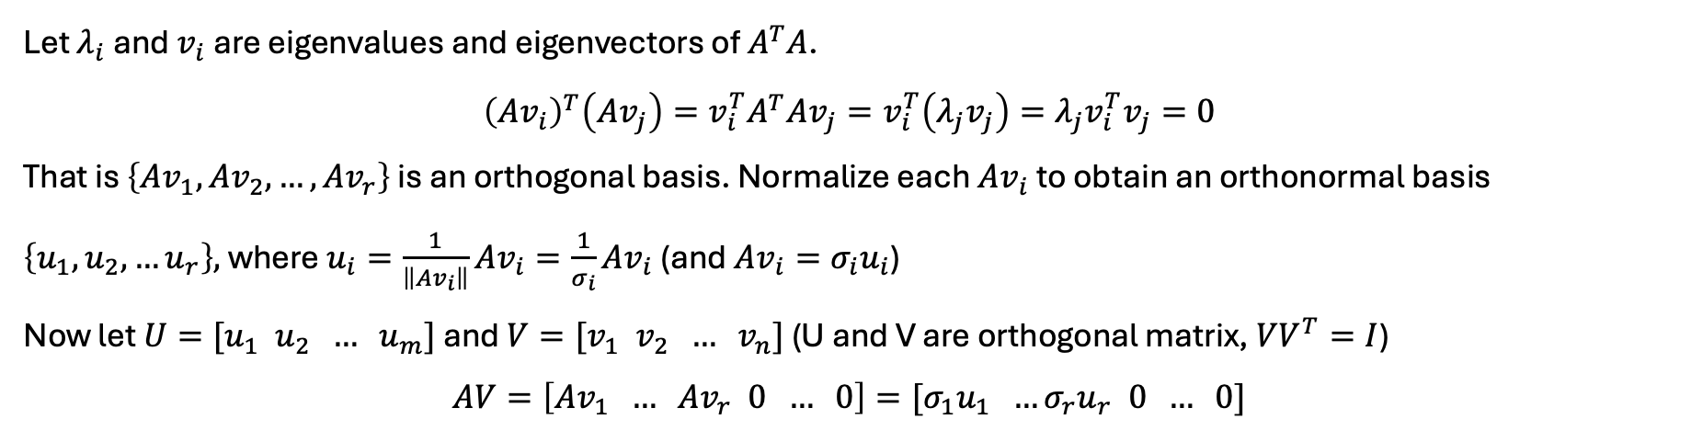
Proof: The Singular Value Decomposition: $A=UΣV^{T}$
Let $λ_{i}$ and $v_{i}$ are eigenvalues and eigenvectors of $A^{T}A$.
$${\left(Av_{i}\right)}^{T}\left(Av_{j}\right)=v_{i}^{T}A^{T}Av_{j}=v_{i}^{T}\left(λ_{j}v_{j}\right)=λ_{j}v_{i}^{T}v_{j}=0$$
That is $\left\{Av_{1},Av_{2},…,Av_{r}\right\}$ is an orthogonal basis. Normalize each $Av_{i}$ to obtain an orthonormal basis $\left\{u_{1}, u_{2},…u_{r}\right\},$ where $u_{i}=\frac{1}{\left\|Av_{i}\right\|}Av_{i}=\frac{1}{σ_{i}}Av_{i}$ (and $Av_{i}=σ_{i}u_{i}$)
Now let $U=[u_{1} u_{2} … u_{m}]$ and $V=[v_{1} v_{2} … v_{n}]$ (U and V are orthogonal matrix, $VV^{T}=I$)
$$AV=\left[Av_{1} … Av_{r} 0 … 0\right]=[σ_{1}u_{1} …σ_{r}u_{r} 0 … 0]$$
$UΣ=\left[u_{1} u_{2} … u_{m}\right]\left[\begin{matrix}σ_{1} & 0 & 0 & 0 & 0 \\ 0 & σ_{2} & 0 & 0 & 0 \\ 0 & 0 & . & 0 & 0 \\ 0 & 0 & 0 & σ_{r} & 0 \\ 0 & 0 & 0 & 0 & 0\end{matrix}\right]=\left[σ_{1}u_{1} …σ_{r}u_{r} 0 … 0\right]=AV$.
Then $UΣV^{T}=AVV^{T}=A$

Slide 10
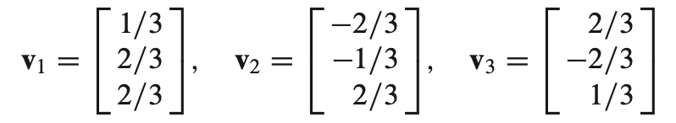
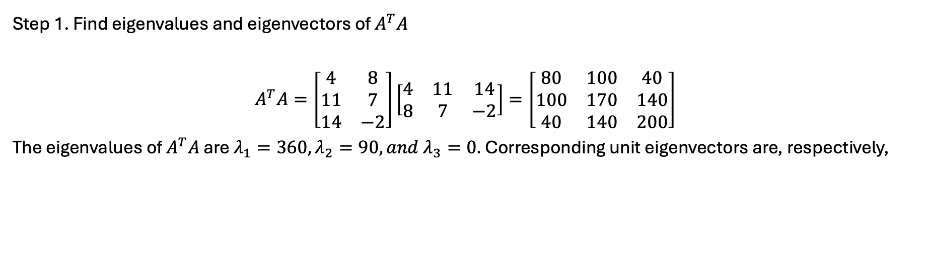
Example: construct a SVD of $A=\left[\begin{matrix}4 & 11 & 14 \\ 8 & 7 & −2\end{matrix}\right]$
Step 1. Find eigenvalues and eigenvectors of $A^{T}A$
$$A^{T}A=\left[\begin{matrix}4 & 8 \\ 11 & 7 \\ 14 & −2\end{matrix}\right]\left[\begin{matrix}4 & 11 & 14 \\ 8 & 7 & −2\end{matrix}\right]=\left[\begin{matrix}80 & 100 & 40 \\ 100 & 170 & 140 \\ 40 & 140 & 200\end{matrix}\right]$$
The eigenvalues of $A^{T}A$ are $λ_{1}=360, λ_{2}=90, and λ_{3}=0.$ Corresponding unit eigenvectors are, respectively,

Slide 11
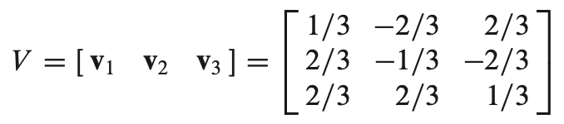

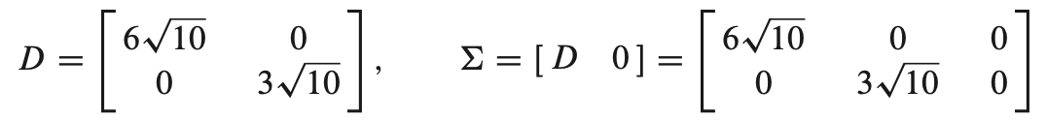
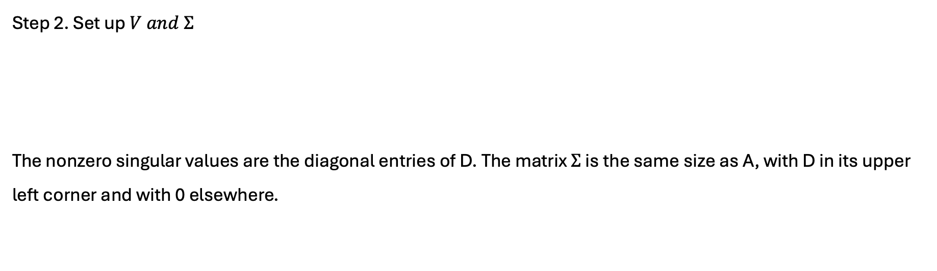
Example: construct a SVD of $A=\left[\begin{matrix}4 & 11 & 14 \\ 8 & 7 & −2\end{matrix}\right]$
Step 2. Set up $V and Σ$
The nonzero singular values are the diagonal entries of D. The matrix $Σ$ is the same size as A, with D in its upper left corner and with 0 elsewhere.

Slide 12
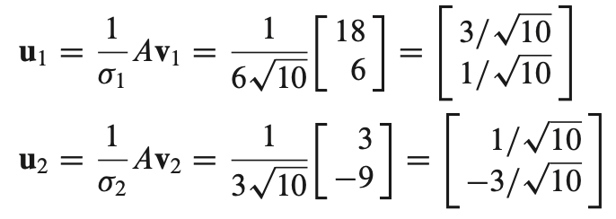
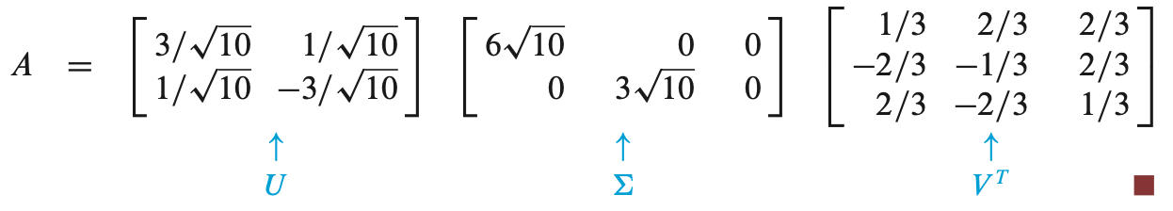

Example: construct a SVD of $A=\left[\begin{matrix}4 & 11 & 14 \\ 8 & 7 & −2\end{matrix}\right]$
Step 3. Construct U. A has two nonzero singular values, so rank A=2. The first 2 columns of U are the normalized vectors obtained from $Av_{1}, …, Av_{r}.$
Note that $\{u_{1}, u_{2}\}$ is already a basis for $R^{2}$. Thus no additional vectors are needed for U, and $U=[u_{1} u_{2}]$.
The singular value decomposition of A is

Slide 13
Session 1: SVD Introduction Geometric Interpretation

Slide 14


What happens when we multiply a vector by a matrix?
Given $v=\left[\begin{aligned}1 \\ 1\end{aligned}\right]$, compute $Av$, draw $v and Av$ on 2D plane.
$A=\left[\begin{matrix}1 & 0 \\ 0 & 1\end{matrix}\right]$, no change
$A=\left[\begin{matrix}2 & 0 \\ 0 & 3\end{matrix}\right]$, scaling/stretch
$A=\left[\begin{matrix}0 & 1 \\ −1 & 0\end{matrix}\right]$, rotation
4. $A=\left[\begin{matrix}1 & 0 \\ 0 & 1 \\ 0 & 0\end{matrix}\right]$, dimension change
5. $A=\left[\begin{matrix}2 & 1 \\ 1 & 2\end{matrix}\right]$, how about this one? (demo)
6. $A=\left[\begin{matrix}4 & 11 & 14 \\ 8 & 7 & −2\end{matrix}\right]$, how about this one? (demo)

Slide 15
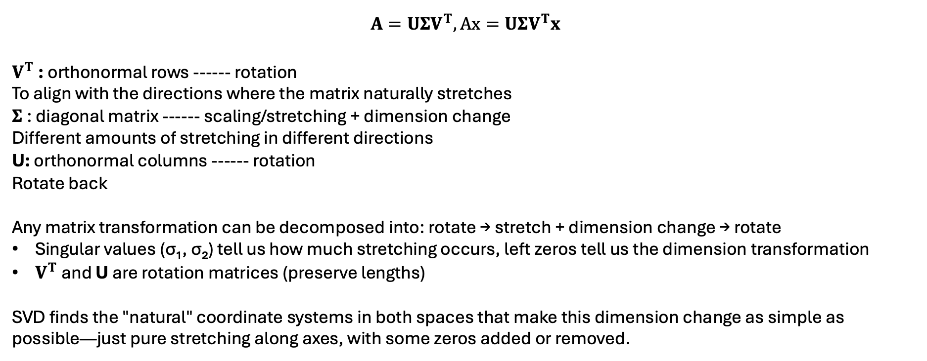
What happens when we multiply a vector by a matrix?
$$A=UΣV^{T},Ax=UΣV^{T}x$$
$V^{T}$: orthonormal rows ------ rotation
To align with the directions where the matrix naturally stretches
$Σ$: diagonal matrix ------ scaling/stretching + dimension change
Different amounts of stretching in different directions
U: orthonormal columns ------ rotation
Rotate back
Any matrix transformation can be decomposed into: rotate → stretch + dimension change → rotate
Singular values (σ₁, σ₂) tell us how much stretching occurs, left zeros tell us the dimension transformation
$V^{T}$and U are rotation matrices (preserve lengths)
SVD finds the "natural" coordinate systems in both spaces that make this dimension change as simple as possible—just pure stretching along axes, with some zeros added or removed.

Slide 16
Session 2: Image Compression Capstone Project Python SVD Tools

Slide 17
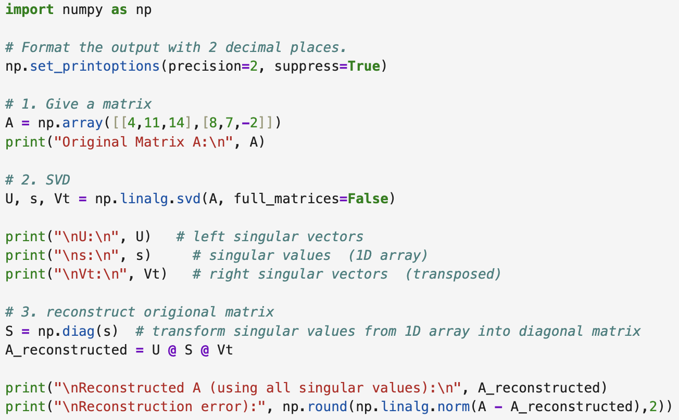
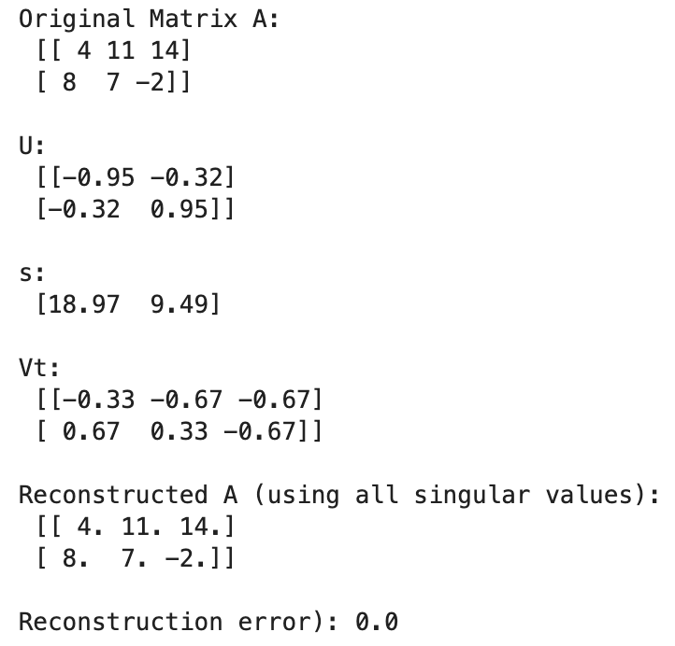
Applications: how to achieve SVD with python

Slide 18
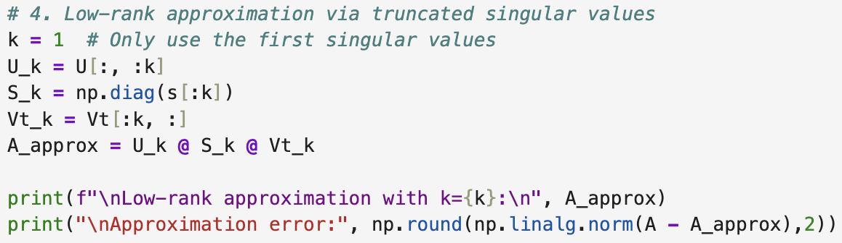
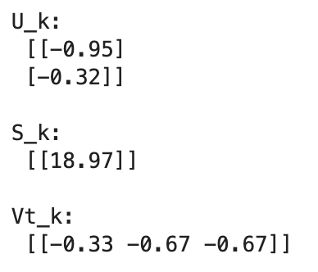
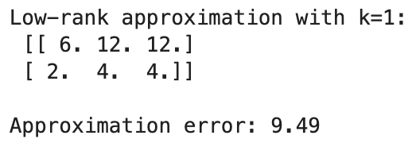
Applications: Low-rank approximation via truncated singular values

Slide 19


Exercises: Use python to get SVD result of following matrices
(1) $A=\left[\begin{matrix}2 & 0 \\ 0 & 1\end{matrix}\right]$
(2) $A=\left[\begin{matrix}2 & 1 & 4 \\ 1 & 2 & 9\end{matrix}\right]$

Slide 20
Session 2: Image Compression Capstone Project Image Compression

Slide 21

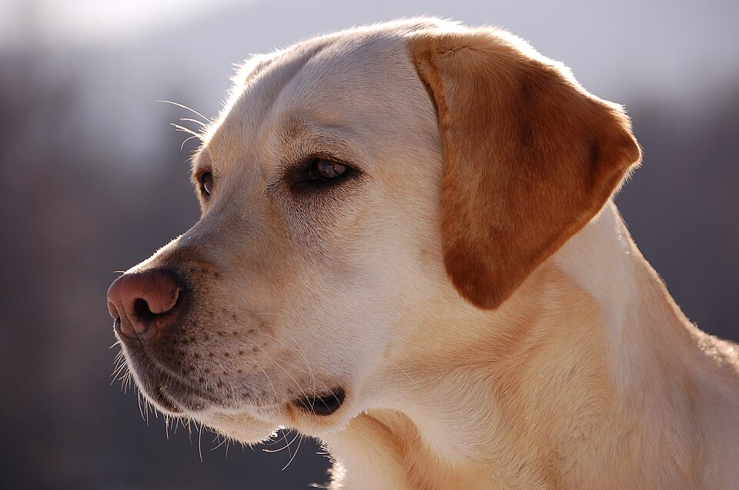
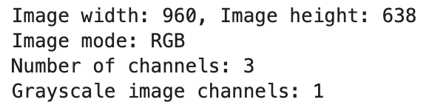
Application: Use SVD to compress images
How is image represented as matrices?

Slide 22
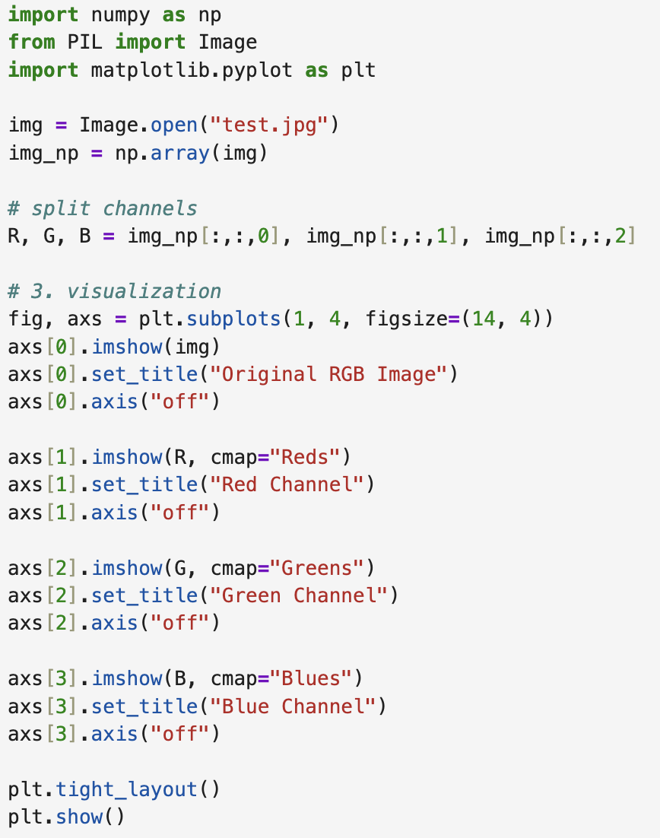

Application: Use SVD to compress images
How is image represented as matrices?
Each channel is a matrix, and each number in the matrix represents the brightness of a pixel in that color channel. (demo)
A higher value indicates a stronger signal or higher brightness in that color channel for the pixel.
How channels work?(demo)

Slide 23

Application: Use SVD to compress images
Why image compression matters?
Single channel image
Original elements: m x n
Parameters after Image compression with SVD:
SVD allows us to represent an image matrix $A$ as a product of three matrices:
$$A=UΣV^{T}$$
U: m x m, $Σ$: min(m , n), $V^{T}$:n x n
By keeping only the top $k$ singular values and their corresponding vectors, we can approximate the image as:
$$A=U_{k}Σ_{k}V_{k}^{T}$$
$U_{k}$: m x k, $Σ_{k}$: k, $V_{k}^{T}$: k x n, total: mk+nk+k
Instead of storing $m×n$ elements, we only need to store $mk+nk+k$ elements. Since $k$is much smaller than $min(m, n)$ , the amount of data is significantly reduced while the main image structure is preserved.
(demo experiment)

Slide 24
Image Compression Capstone Project and Presentation
Introduction to SVD
Why SVD can be used for image compression
Achieve grayscale image compression with SVD
Experiment with different numbers of singular values (k=1,5,10,20 etc)
Calculate compression ratios (original size vs. compressed representation)
Visual comparison: display original vs. reconstructed images side by side
Analyze singular value decay: plot σ_i values
Measure reconstruction error: ||A - A_k||_F (Frobenius norm)
Find optimal k for different quality/compression trade-offs
Give your own opinions
3. Try images with different sizes(50x50、2000x3000)/styles(portrait/natural scene/medical image etc.) (Optional)
4. Try RGB images (Optional)
Submit PPT and Code(.py/.ipynb) (next Wednesday)
Present tomorrow

Slide 25
Good Presentation
A clear logic
2. PPT: Power points. What is power points?
No need for many words displayed
Express in your own words after you understand
3. Use figures or tables to help you illustrate
4. Pay attention to the word size. Are they too small or too big for the audience?

Slide 26
Thanks & Questions

